Slide 1

Predicting Pedestrian Casualties in NYC
Presented by
Yehuda Hecht

Slide 2
1. The Problem
Pedestrian casualties and Vision Zero

Slide 3
Not even a single tragedy on our streets is acceptable, and we’ll keep fighting every day to protect our people.
- Bill de Blasio, Mayor, NYC
<number>

Slide 4
Vision Zero
Program began in 2014
Inspired by a Swedish theory that pedestrian deaths are not as much "accidents" as they are a failure of street design
Program introduced slow zones and improved pedestrian signals, among other protocols
<number>

Slide 5
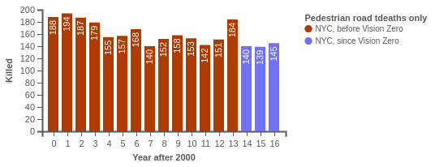
Vision Zero
Pedestrian casualties have not gone down drastically since the beginning of the program:
<number>

Slide 6
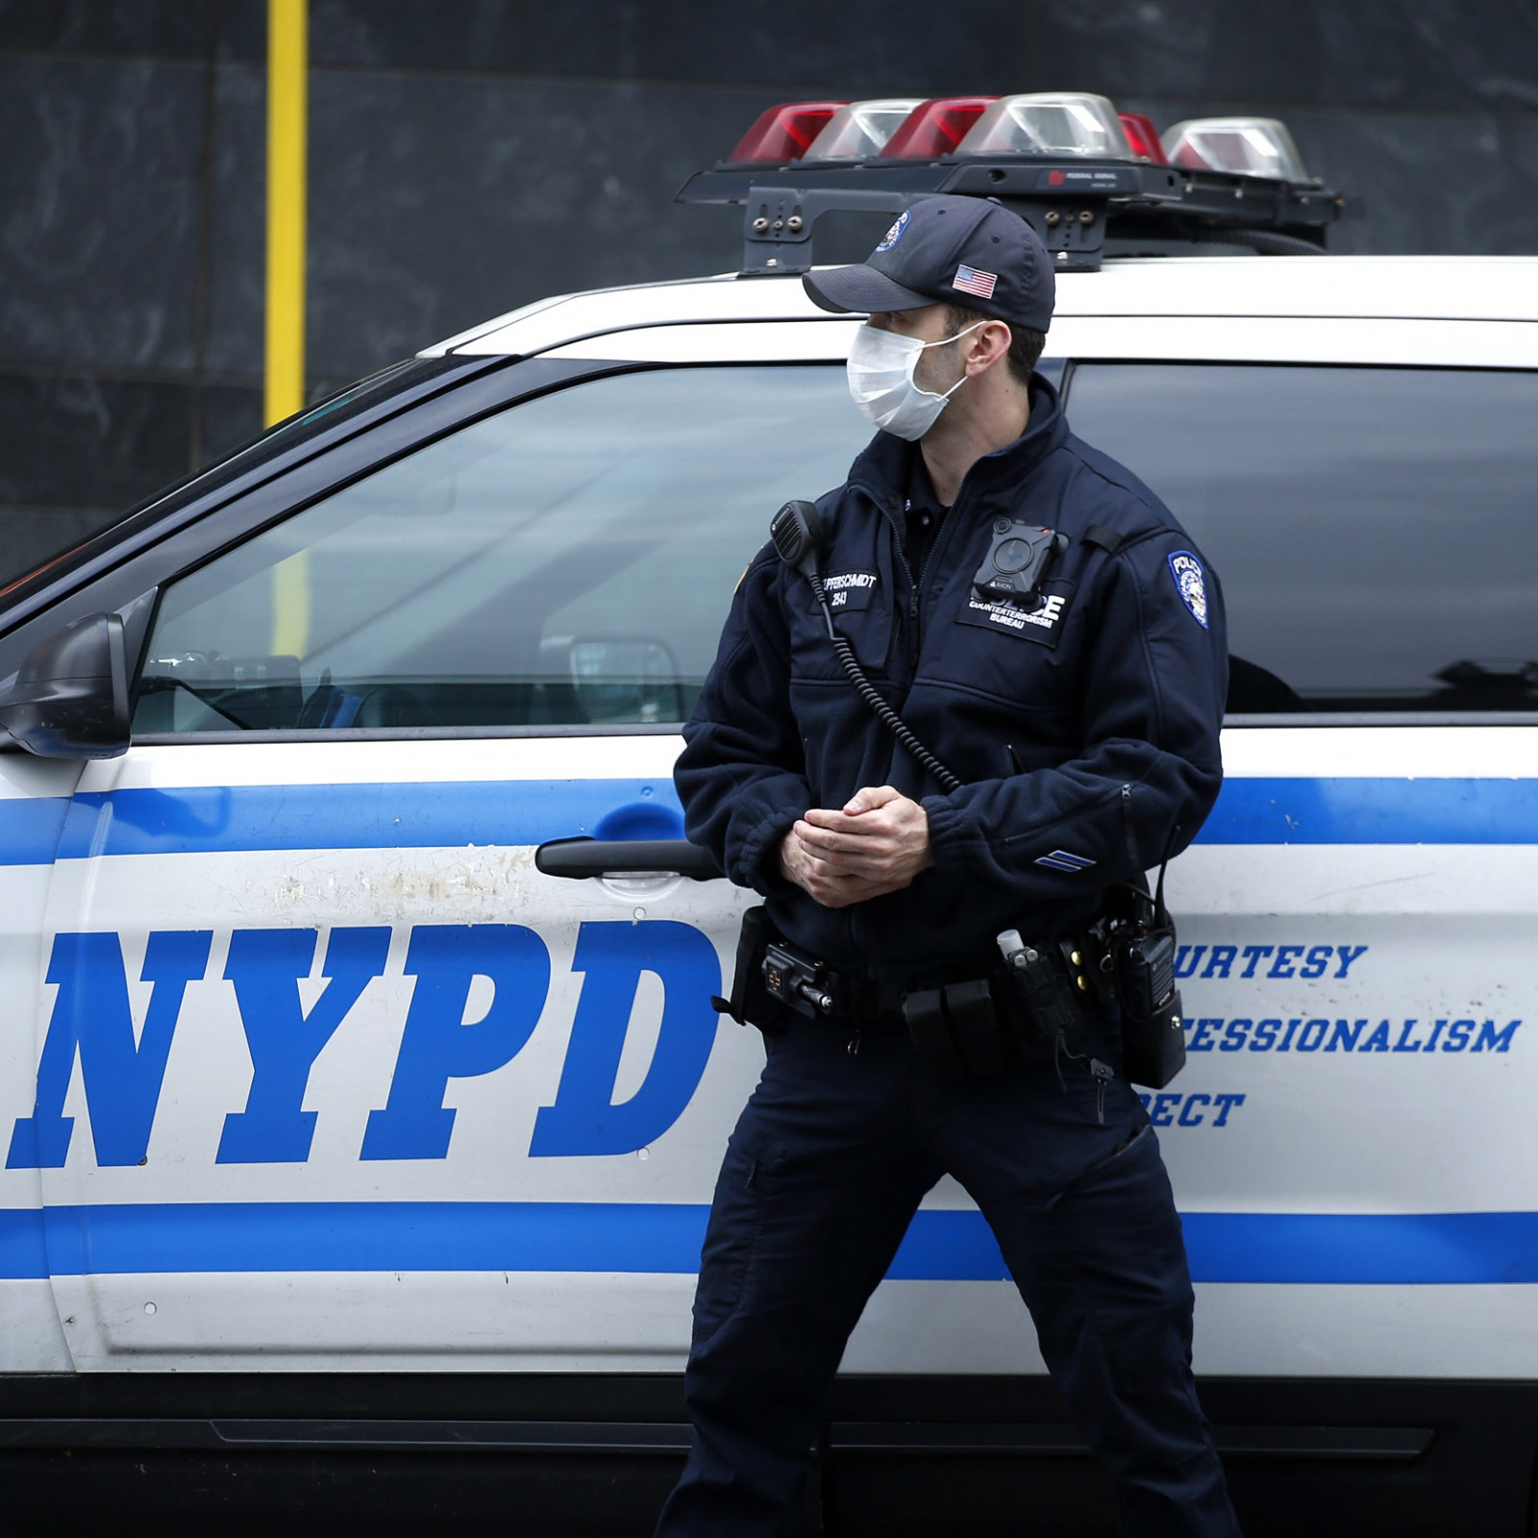
Model objective
A finite resource, the usage of increased police presence may be an effective deterrent to pedestrian casualties. The model’s purpose is to determine the time and place of highest likelihood of pedestrian casualty.
<number>

Slide 7
2. The Data
The NYC OpenData MVA data set

Slide 8
8
Years of data
1,697,572
Total accidents
220,390
Unique locations
<number>

Slide 9
Data breakdown
Time/Location
Crash date
Crash time
Borough
Zip Code
Latitude
Longitude
Street name
Off street name
Cross street name
People
Number of pedestrians killed/injured
Number of cyclists killed/injured
Number of motorists killed/injured
Context
Contributing factors
Vehicle types
<number>

Slide 10
Target variable aggregation
Number of pedestrians killed
Number of pedestrians injured
Number of cyclists killed
Number of cyclists injured
<number>

Slide 11
3. The Model
Features and modeling

Slide 12
Feature engineering
New features | Derived from:
Daytime | Date/time of accident and sunrise/sunset data
Weekend | Date data
Rush Hour | Time of accident
Clusters | KNN clustering of geospatial data
<number>

Slide 13
Final model feature set
Clusters
Hyperparameter tuning was performed to determine the best number of clusters for each burough.
Year/month/season
Year, month, year+month, and season were all included for the purpose of seasonality and trend consideration.
Hour/Daytime/Rush hour
The specific hour, as well as a categorical dummy declaring morning or evening rush hour and daytime or not.
Weekdays
The actual days of the week, as well as a categorical variable differentiating between weekday and weekend.
Street names/Cross street names
The names of the streets and cross streets. Names were cleaned (e.g. “Street” to “St”) and count-vectorized.
Contributing factors
The actual reasons for the accident were included. Unavoidable situations (e.g. brake failure) were removed.
<number>

Slide 14
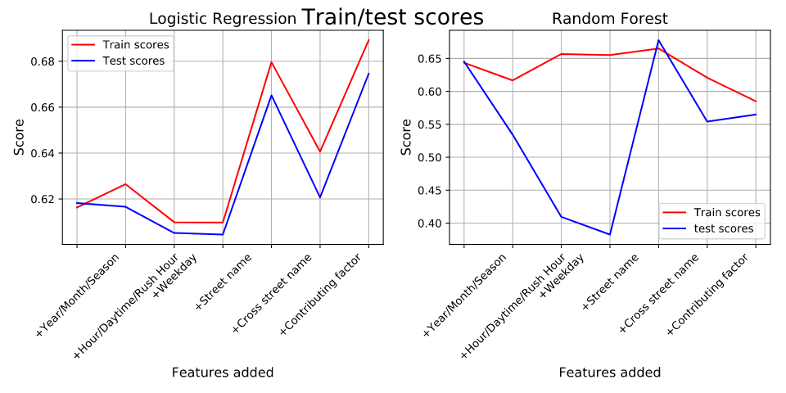
Model comparisons
Recall was used as a metric, because false negatives were important to penalize and because the data was highly imbalanced.
<number>

Slide 15
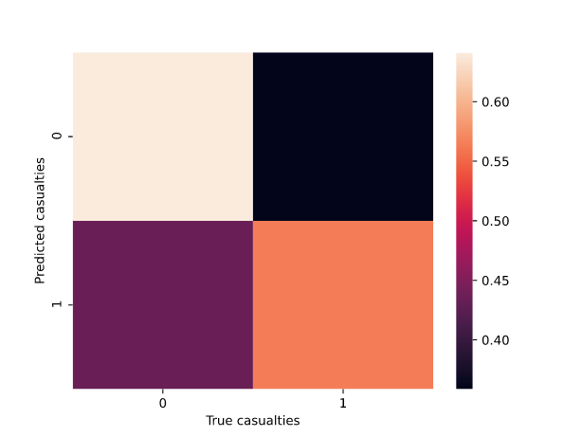
Final model
Final model
Logistic regression
<number>

